Slide 1
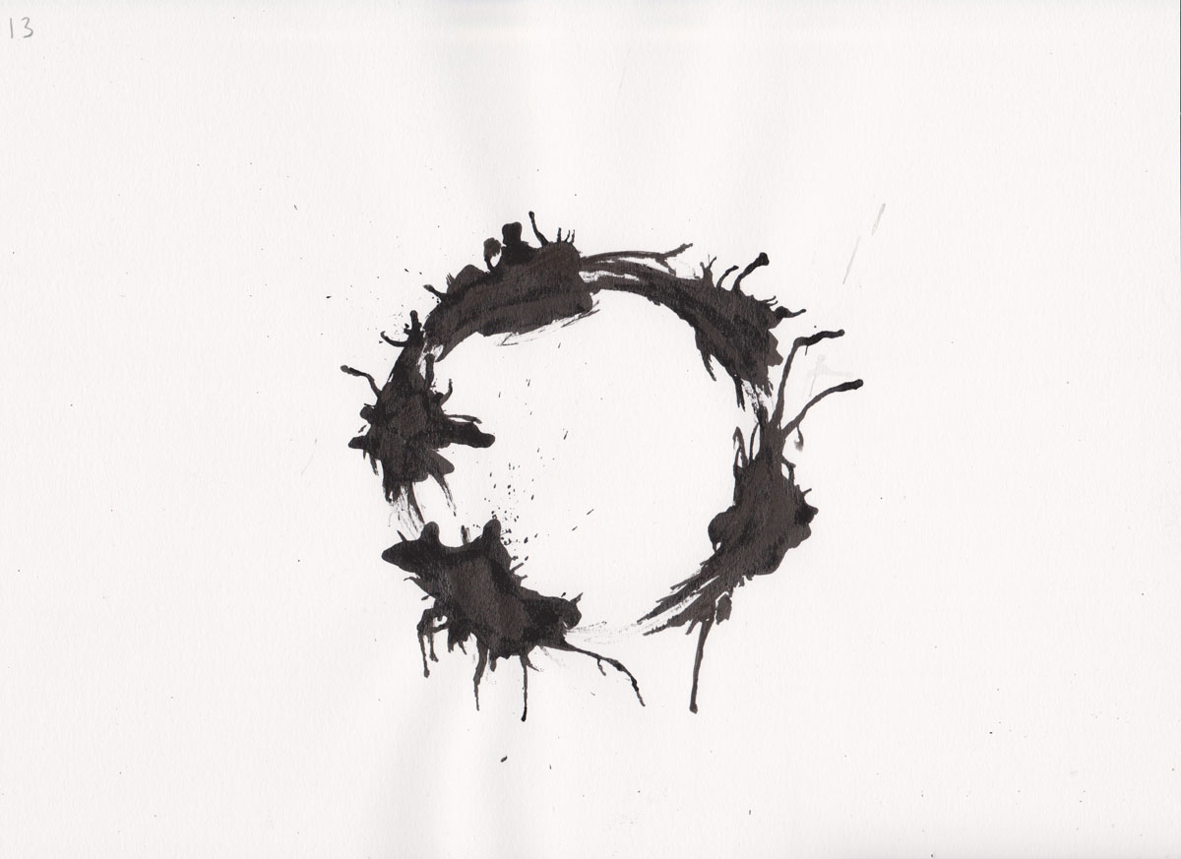
Self-consistent dynamics along closed time-like curves
how to shoot your past self and get away with it
Ä. Baumeler, FC, T. Ralph, S. Wolf, M. Zych
Reversible time travel with freedom of choice arXiv:1703.00779
G. Tobar, FC
Reversible dynamics with closed time-like curves and freedom of choice arXiv:2001.02511
Paul Scherrer Institute/online
19 May 2022
Art from “The Arrival”

Slide 2
Is time travel possible?

Slide 3

Travel to the future

Slide 4
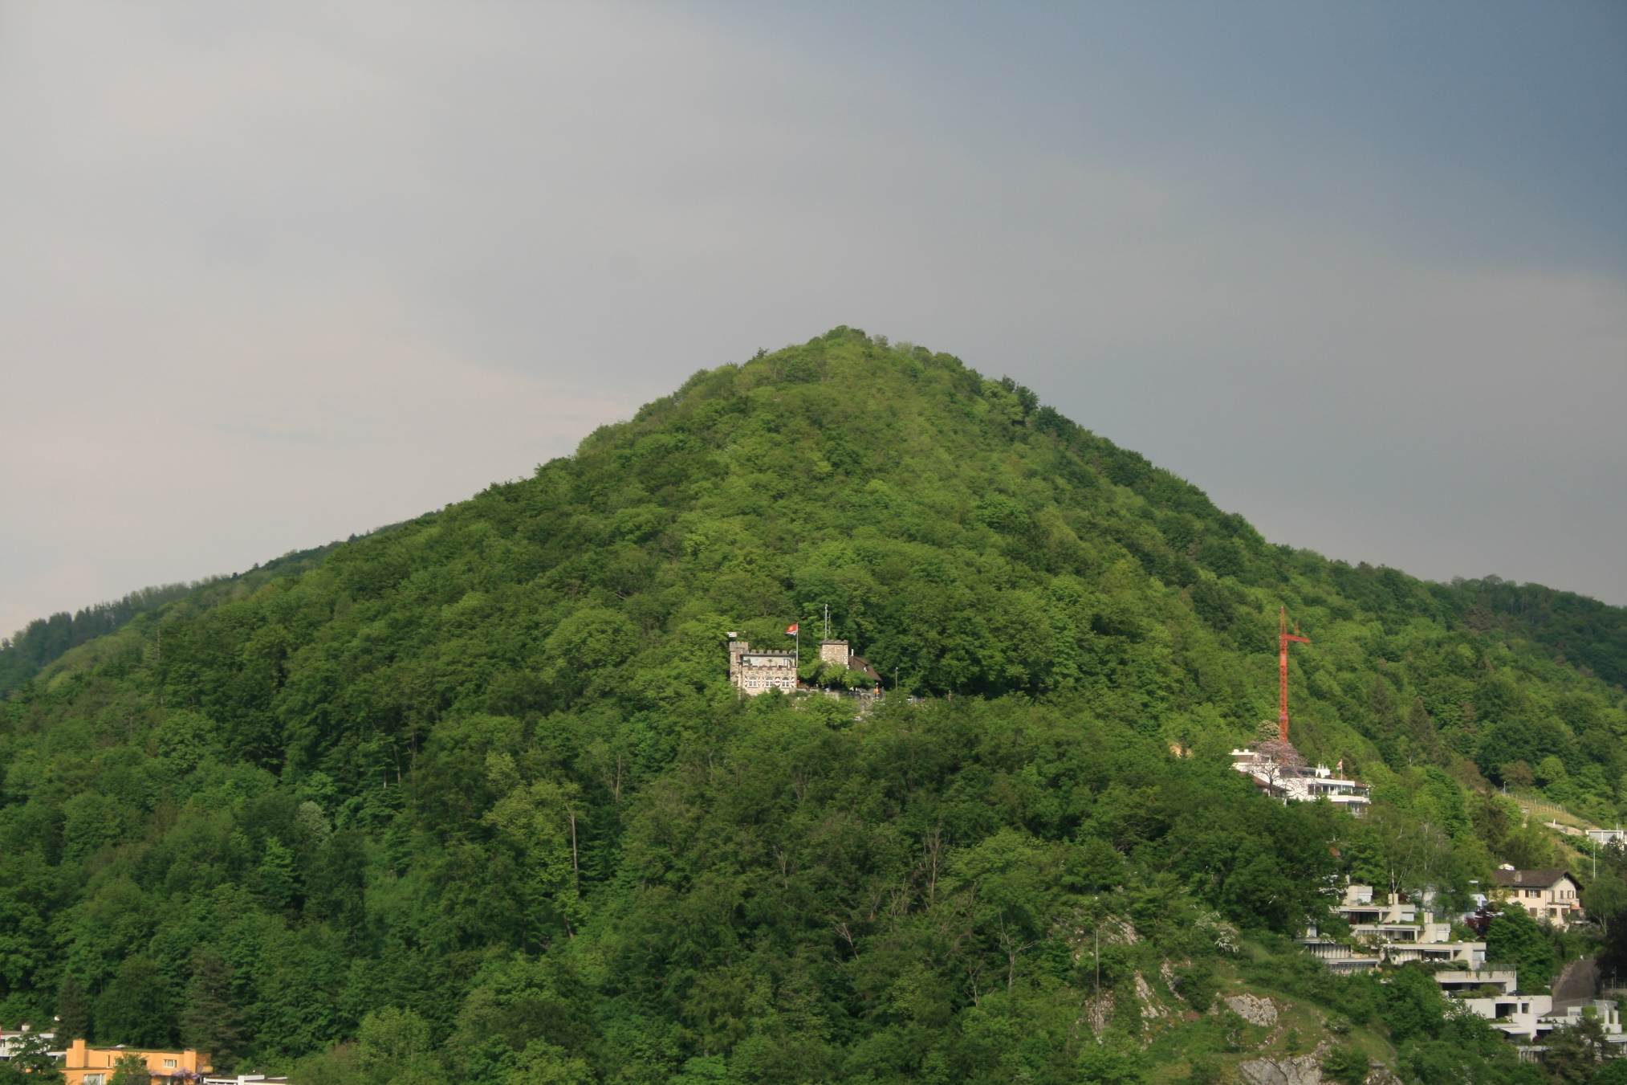



Travel fast forward
General relativity: time dilation
“Lower is slower”
Tested to high precision
Crucial for GPS

Slide 5
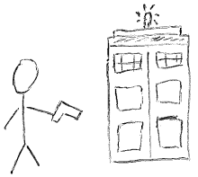
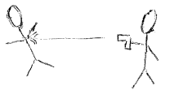
Travel to the past?
Monday
?
Sunday

Slide 6
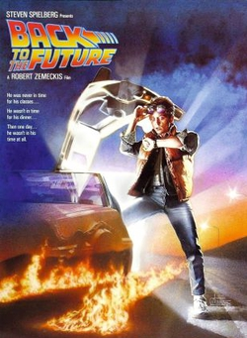
The sci-fi problem
Reconcile time loops with linear story-telling
Self consistency Predestination, Interstellar, Tenet
Parallel universes Terminator, Back to the Future (II)
Magic Back to the Future (I)

Slide 7

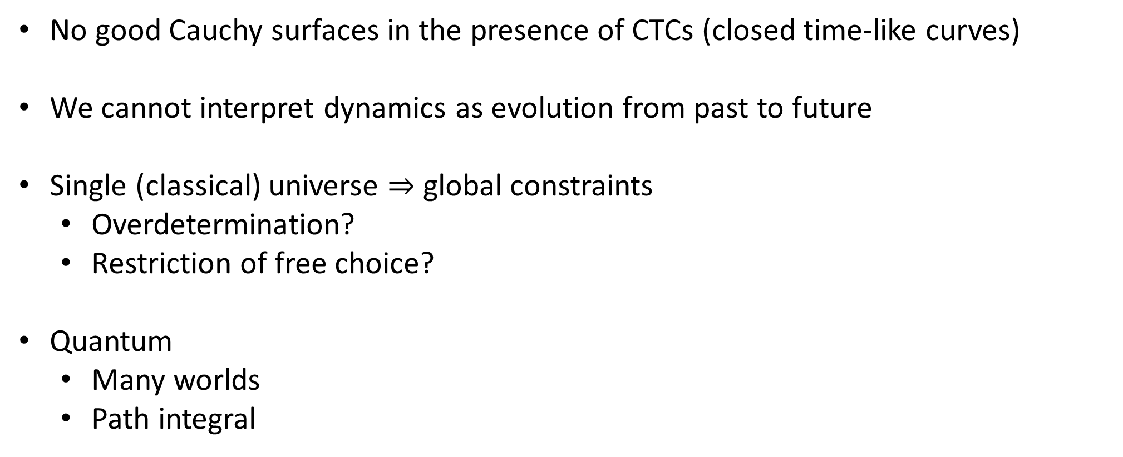
The physics problem
No good Cauchy surfaces in the presence of CTCs (closed time-like curves)
We cannot interpret dynamics as evolution from past to future
Single (classical) universe $⇒$ global constraints
Overdetermination?
Restriction of free choice?
Quantum
Many worlds
Path integral
Violation of local physics?
$⇒$ nonlinearity

Slide 8
PLAN
Wormholes and CTCs – early works.
Framework for classical dynamics with freedom of choice near CTCs.
Examples: non-trivial time travel with freedom of choice.
Physical realisation.
Quantum time travel and indefinite causal order.

Slide 9
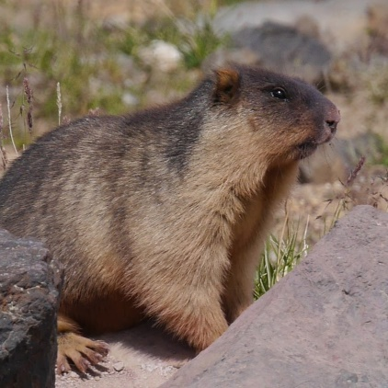
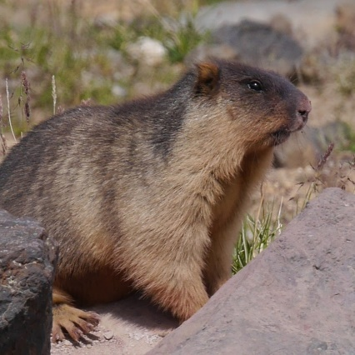
Wormholes
Minkowski metric, except for two spherical spatial regions “cut out” and identified
M. S. Morris and K. S. Thorne, American Journal of Physics, 56, 395 (1988)

Slide 10












Wormholes
Accelerate a mouth  time dilation  CTCs
$$τ_{5}$$
$$τ_{7}$$
$$τ_{4}$$
$$τ_{6}$$
CTC
$$τ_{5}$$
$$τ_{3}$$
$$τ_{4}$$
$$τ_{3}$$
$$τ_{2}$$
$$τ_{2}$$
$$τ_{1}$$
$$τ_{1}$$
World lines of the mouths
M. S. Morris, K. S. Thorne, and U. Yurtsever, Phys. Rev. Lett. 61, 1446 (1988)

Slide 11


Wormholes
Exit can be earlier than entrance

Slide 12












Physics around wormholes traditional approach
Set initial conditions in the past of the CTCs
Look for solutions of equations of motion
Does a solution exist for all initial conditions?
How many solutions?
$$τ_{5}$$
$$τ_{7}$$
$$τ_{4}$$
$$τ_{6}$$
$$τ_{5}$$
$$τ_{3}$$
$$τ_{4}$$
No CTCs
$$τ_{3}$$
$$τ_{2}$$
$$τ_{2}$$
$$τ_{1}$$
$$τ_{1}$$
Past space-like surface

Slide 13
Physics around wormholes
Send billiard ball towards a mouth
Inconsistency? (No solution?)
Consistent solutions always exist (for the cases studied)
F. Echeverria, G. Klinkhammer, and K. S. Thorne, Phys. Rev. D 44, 1077 (1991)

Slide 14
Physics around wormholes
Typically, multiple solutions exist

Slide 15
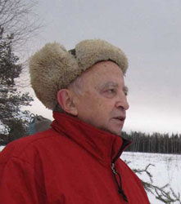
Novikov principle: only self-consistent solutions happen
Conjecture: all initial conditions have a self-consistent solution
Arbitrary preparation possible
The physics of a device or agent in the past is not affected by the presence of CTCs in the future. “No new physics” principle.
How about operations in the CTC era?
I. D. Novikov, Phys. Rev. D 45 (1989)

Slide 16














Stronger version of the principle
“No new physics” for every local region without CTCs
In a CTC-free region, all operations available in ordinary space-time are possible
“Dynamics” is the solution to a boundary conditions problem
$$τ_{9}$$
$$τ_{5}$$
$$τ_{8}$$
$$τ_{4}$$
$$τ_{7}$$
$$τ_{3}$$
e.g., determine states on past boundaries as a function of states on the future boundaries
$$τ_{6}$$
$$τ_{2}$$
$$τ_{5}$$
$$τ_{1}$$
$$τ_{4}$$
$$τ_{0}$$
$$τ_{3}$$
$$τ_{−1}$$

Slide 17

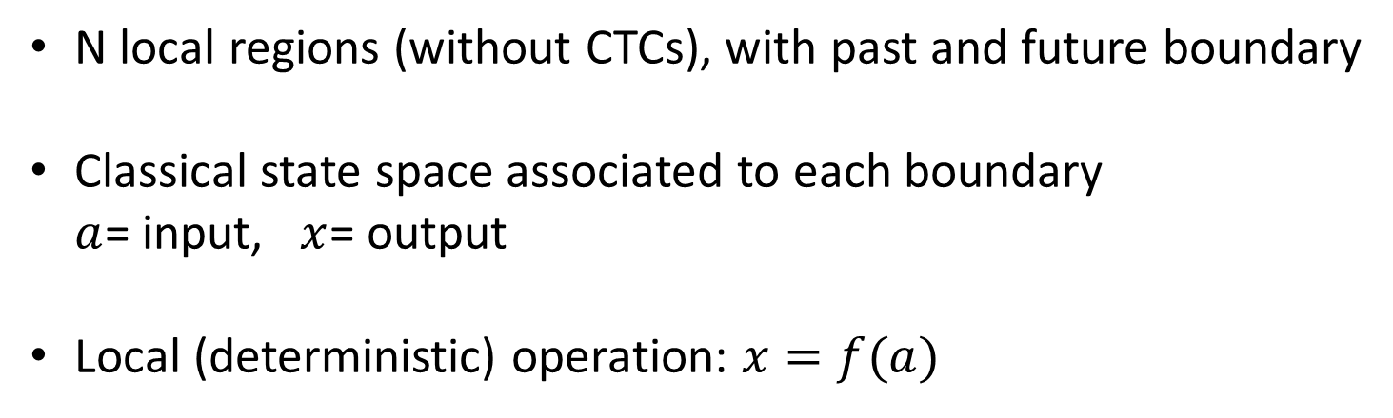


Framework for dynamics near CTCs
N local regions (without CTCs), with past and future boundary
Classical state space associated to each boundary $a$= input, $x$= output
Local (deterministic) operation: $x=f(a)$
$$x$$
$$f$$
$$a$$

Slide 18
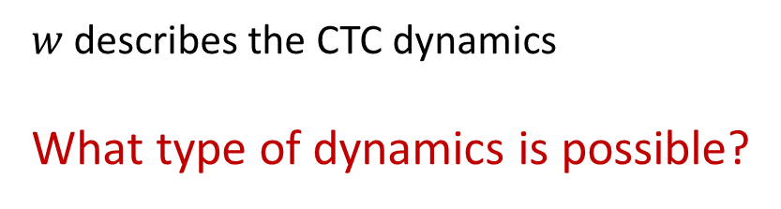











Process function
$\left\{a_{1},…,a_{N}\right\}=w\left(x_{1},…,x_{N}\right)$
Consistency condition:
$$∀f=\left\{f_{1},…,f_{N}\right\}$$
$$∃ a=\left\{a_{1},…,a_{N}\right\}$$
Such that
$$w∘f\left(a\right)=a$$
$$w$$
$$x_{N}$$
$$x_{1}$$
$$x_{2}$$
$$f_{1}$$
$$f_{2}$$
$$f_{N}$$
$$a_{N}$$
$$a_{1}$$
$$a_{2}$$
$w$ describes the CTC dynamics
What type of dynamics is possible?

Slide 19


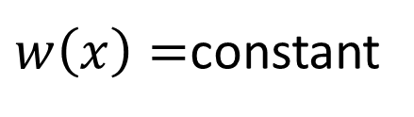


Single region
$w\left(x\right)=$constant
$$x$$
$$w$$
$$f$$
$$a$$
Cannot send information back to yourself

Slide 20





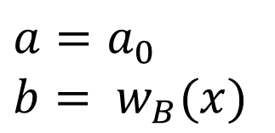

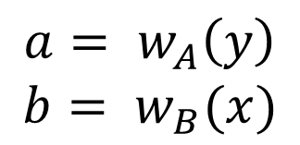


Two regions
$$w=\{w_{A},w_{B}\}$$
$$w$$
$$a= w_{A}\left(y\right)$$
$$b= w_{B}(x)$$
$$x$$
$$y$$
$$A$$
$$B$$
$$a$$
$$b$$
At least one of the two components must be constant
$$a=a_{0}$$
$$b= w_{B}(x)$$
Only one-way signalling

Slide 21


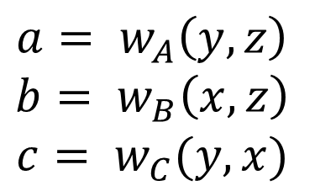









characterisation of process functions
$$y$$
$$x$$
$$B$$
Three regions:
$$A$$
$$b$$
$$w$$
$$a$$
$$w=\{w_{A},w_{B},w_{C}\}$$
$$z$$
$$a= w_{A}\left(y,z\right)$$
$$b= w_{B}\left(x,z\right)$$
$$c= w_{C}(y,x)$$
$$C$$
$$c$$
Necessary and sufficient:
Fixing the output of one of the parties, only one-way signally is possible between the other two
One-way conditional signalling

Slide 22


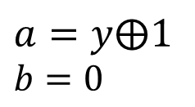















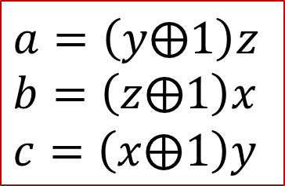
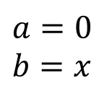
Three regions
$$y$$
Example
$$B$$
$$x$$
$$A$$
$$b$$
$$a,…,z=0, 1$$
$$w$$
$$a$$
$$a=\left(y⨁1\right)z$$
$$b=\left(z⨁1\right)x$$
$$c=\left(x⨁1\right)y$$
$$z$$
$$C$$
$$c$$
$$z=0$$
$z=$1
$$a=0$$
$$b=x$$
$$a=y⨁1$$
$$b=0$$
Incompatible with causal order
$$A⇝B$$
$$B⇝A$$
$$B⇝A$$
$$A⇝B$$

Slide 23
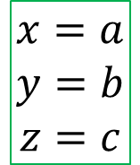
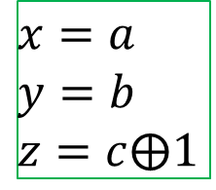
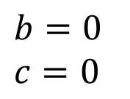

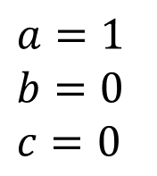
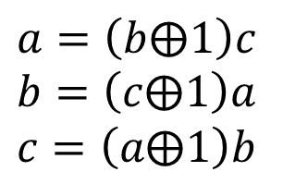



Three regions
$$y$$
Example
$$B$$
$$x$$
$$A$$
$$b$$
$$w$$
$$a=\left(y⨁1\right)z$$
$$b=\left(z⨁1\right)x$$
$$c=\left(x⨁1\right)y$$
$$a$$
$$z$$
$$C$$
$$c$$
Compatible with arbitrary local operations. Operations determine unique solution.
$$x=a$$
$$y=b$$
$$z=c$$
$$a=\left(b⨁1\right)c$$
$$b=\left(c⨁1\right)a$$
$$c=\left(a⨁1\right)b$$
$$x=a$$
$$y=b$$
$$z=c⨁\text{1}$$
$$a=1$$
$$b=0$$
$$c=0$$
$$⟶$$
$$a=\left(b⨁1\right)b\left(a⨁1\right)=0$$
$$⟶$$
$$b=0$$
$$c=0$$

Slide 24
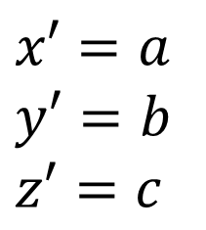

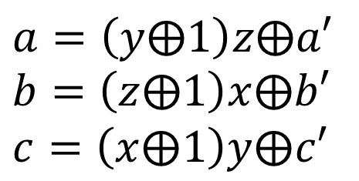

characterisation of process functions
$$x^{′},y^{′}, z′$$
Three regions. Example – reversible extension
$$y$$
$$x$$
$$B$$
$$x′=a$$
$$y′=b$$
$$z′=c$$
$$A$$
$$b$$
$$a=\left(y⨁1\right)z⨁a′$$
$$b=\left(z⨁1\right)x⨁b′$$
$$c=\left(x⨁1\right)y⨁c′$$
$$w$$
$$a$$
$$z$$
$$C$$
$$c$$
$$a^{′},b^{′}, c′$$
Can be realised as a collision model

Slide 25

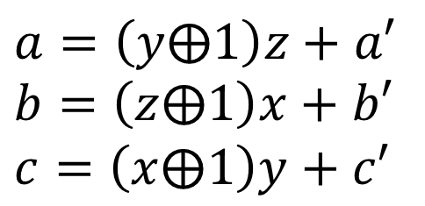
characterisation of process functions
$$x^{′},y^{′}, z′$$
Three regions. Example – reversible extension
$$y$$
$$x$$
$$B$$
$$x′=a$$
$$y′=b$$
$$z′=c$$
$$A$$
$$b$$
$$a=\left(y⨁1\right)z+a′$$
$$b=\left(z⨁1\right)x+b′$$
$$c=\left(x⨁1\right)y+c′$$
$$w$$
$$a$$
$$z$$
$$C$$
$$c$$
$$a^{′},b^{′}, c′$$
Can be realised as a collision model

Slide 26
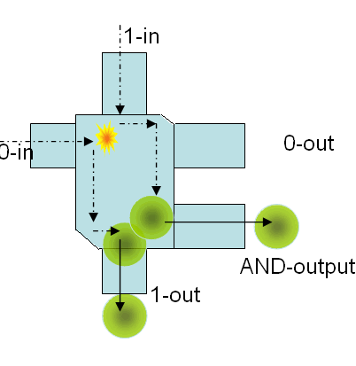


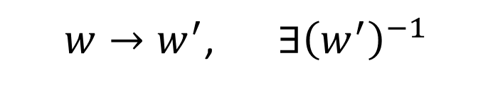









Reversible processes
$$a′$$
Every process can be extended to a reversible one
When you have eliminated all which is impossible, then whatever remains, however improbable, must be the truth
$$w′$$
$$w$$
$$x_{1}$$
$$x_{2}$$
$$x_{N}$$
$w→w^{′}$, $∃{\left(w^{′}\right)}^{−1}$
$$f_{1}$$
$$f_{2}$$
$$f_{N}$$
$$a_{1}$$
$$a_{2}$$
$$a_{N}$$
Can be realised with physical systems!
$$x^{′}$$
E. Fredkin and T. Toffoli, Int J Theor Phys 21, 219 (1982)

Slide 27


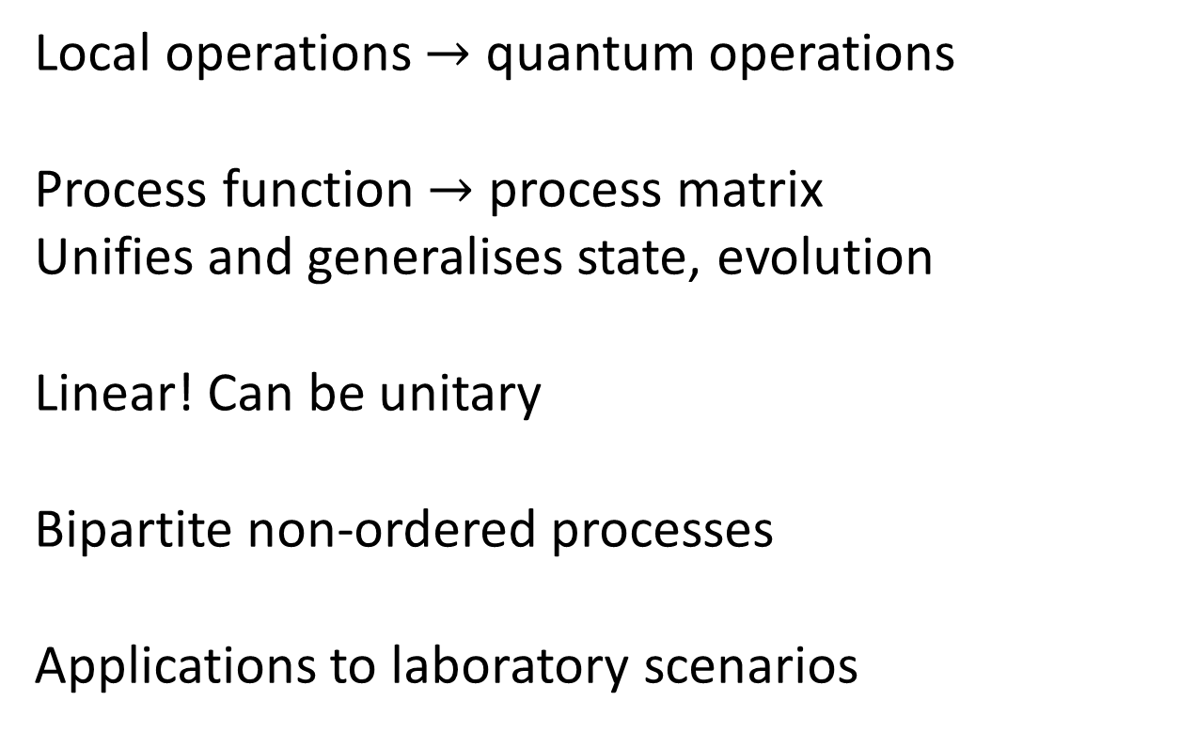


Quantum framework
Local operations $→$ quantum operations
Process function $→$ process matrix
Unifies and generalises state, evolution
Linear! Can be unitary
Bipartite non-ordered processes
Applications to laboratory scenarios
$${ A}_{O}$$
W
$${ B}_{O}$$
$${ A}_{I}$$
$${ B}_{I}$$
O. Oreshkov, FC, and Č. Brukner, Nat. Commun. 3, 1092 (2012)

Slide 28
Conclusions
Time travel perhaps not possible, but fun to study
Classical, reversible time travel logically possible
Physically?
What does a time travel experience? (Patch different regions together.)
Quantum causal structures: relevant for quantum gravity?

